Slide 1
Solent Growth Forum Economic Recovery Discussion
Facilitated by Lichfields 26 June 2020

Slide 2
Structure
Covid-19 macro-economic outlook
Planning for economic recovery
Alignment with Solent 2050
Points for discussion

Slide 3
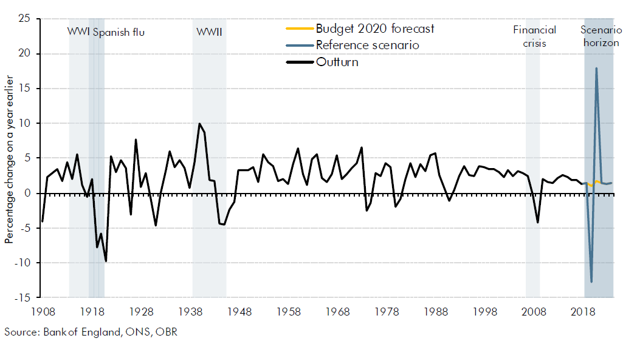
An unprecedented economic shock
Full extent of economic disruption still unfolding, and much will depend on timing and nature of lockdown easing
UK economy contracted by a record 20% in April as lockdown fully ‘kicked in’
The OBR’s ‘V-shaped’ scenario suggests UK GDP could drop by 35% in Q2 before bouncing back later in 2020
Result is a 13% fall in annual GDP in 2020 which is significant in historical terms

Slide 4
Potential implications for Solent
If this macro-level scenario is replicated in the Solent, the short term economic impact could equate to nearly £11 billion
The Solent's gateway economy could feel the impact of the closure of global economies more than most
Strong local representation in other key sectors most significantly impacted by Covid-19 such as visitor economy which will face challenges as a result of universal travel restrictions
Individual business resilience across all sectors will be tested in both the short and longer terms as companies face cash flow challenges, supply chain and workforce disruption and falls in domestic and export markets

Slide 5
Planning for economic recovery
Dedicated Economic Recovery Plan to support transition of the Solent’s economy back to a state of relative normality, and eventual growth, once the pandemic eases
Focus on short term actions over next two years – bridging immediate Covid-19 business support measures with longer term growth and productivity ambitions for the Solent
Practical resource for the LEP and its partners that identifies cross-cutting interventions including:
Provision of sustained support to the local business community
Skills enhancements through the Skills Advisory Panel to support the resident workforce
Renewed emphasis on the LEP’s capital investment programme

Slide 6
Planning for economic recovery
Scope of work follows three key stages:
Economic impacts of Covid-19
Broad areas of intervention
Action plan
Overview of impacts upon the Solent’s economy, including locations and sectors that have been (and will be) hardest hit by the pandemic and associated lockdown
Identifying a range of responses to help address these impacts and support the Solent’s economy to recover and return to a relative state of normality (‘business as usual’)
Drawing together a focused action plan that sets out how the identified interventions will be achieved, funding/resources available and associated timescales
Focused consultation and engagement with key sector groups and stakeholders

Slide 7
Solent 2050
An ambitious and long-term vision and strategy to boost productivity and prosperity across the Solent
Economic recovery will represent an early stage focus of Solent 2050 and strategy delivery
Actions in the Economic Recovery Plan will be framed around, and respond to, six strategic priorities
Solent 2050:
To be the global leader in maritime and climate change adaptation, with towns and cities that are fantastic places to live, trade and with opportunities for all our communities to flourish.
Our vision is underpinned by six priorities:
A world-leading marine and maritime economy
Pioneering approaches to climate change adaptation and decarbonisation
The UK’s capital of coastal renaissance
A thriving visitor and cultural economy
Developing a world-class talent base
An outstanding business environment

Slide 8
Emerging themes
Accelerating key development and infrastructure projects to kick start investment and stimulate economic activity
Sector-specific interventions tailored to the Solent’s key industries and clusters (maritime, tourism/hospitality, manufacturing etc)
Responsive skills provision – inc specific opportunities for re-training, business start-up, digital skills/e-commerce
Recasting/evolving business support offer as we transition from restart recover renew
Boosting local consumer demand and confidence – attracting spending back to town/city centres through promotional activity, local purchasing campaigns and community projects

Slide 9
Points for discussion
Key areas of Covid-19 impact upon the Solent’s economy, and how different sectors and locations have been affected:
Short-term (i.e. following initial period of lockdown and associated restrictions)
Medium-term (i.e. as lockdown restrictions are eased and we transition to a ‘new normal’)
Potential opportunities for intervention and support required to ‘restart’ economic activity and guide economic recovery
Does the Covid-19 pandemic (and its aftermath) present any growth and innovation opportunities for the Solent and its business community?

Slide 10
This publication has been written in general terms and cannot be relied on to cover specific situations. We recommend that you obtain professional advice before acting or refraining from acting on any of the contents of this publication. Lichfields accepts no duty of care or liability for any loss occasioned to any person acting or refraining from acting as a result of any material in this publication. Lichfields is the trading name of Nathaniel Lichfield & Partners Limited. Registered in England, no.2778116. Registered office: The Minster Building, 21 Mincing Lane, London, EC3R 7AG © Nathaniel Lichfield & Partners Ltd 2020. All rights reserved.

