Slide 1
Responding to COVID-19 Update May 2020

Slide 2
COVID-19 : A new paradigm
Global economies re-opening for business
State intervention high – this sector will grow as credit guarantees issued reach 15% of GDP and emergency stimulus measures are implemented
Economic resilience will be tested - 35% fall in economic output in period April to June 2020 with some bounceback
Business resilience will be tested - many businesses may not secure the cash they need to survive this.

Slide 3
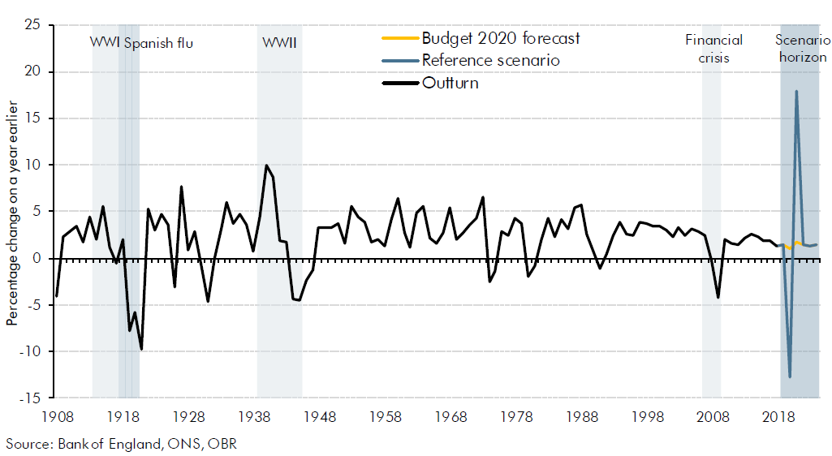
COVID-19 : Business and Economy

Slide 4
COVID-19: RAG rating for key sectors
Sector | Impact now | Impact in Q1 – Q3
Food and drink retail | Demand: Unpredictable spikes in demand Supply: Supply chain disruption Workforce: high risk of infection | Cashflow / lease costs / payroll Disruption to business / supply chains by Jun-Aug
Energy/utilities | Demand: Unpredictable spikes in demand (lockdown & isolation) | Supply chain disruption Workforce continuity
Health and social care | Demand: Increasing Workforce: Pre-existing workforce shortage | Rising demand, lack of workforce
Freight / logistics | Demand: Change in nature of demand Workforce: Pre-existing workforce shortage | Current and future workforce shortages impact distribution Global trade and new trading arrangements post BREXIT
Insurance | Demand: Steady increase in insurance claims | Insurance losses could be heavy
Banking | Proactively supporting vulnerable firms Little stress in funding markets currently | Reserves run short Cash flow / liquidity difficulties

Slide 5
COVID-19: RAG rating for key sectors
Sector | Impact now | Impact in Q1 – Q3
Hospitality / tourism | Demand: Sharp decline in trade since Jan c. 500,000 redundancies in past week Seasonal hires of c 500,000 cancelled | National changes seeing 70% drop in bookings YOY Likely lose a full season of trade
Aviation / Travel | Demand: has declined rapidly | Revenue and cashflow crisis Unlikely international travel will recver significantly in 2020
Retail & wholesale | Demand: for non-food retail depressed Supply: severe supply chain disruption Workforce: high risk of infection | Recession stifles demand Cashflow problems – salaries and leases Disruption to supply chain
Manufacturing | Demand: urgent for some products Limited demand for others – e.g. automotive | Fall in export market and domestic demand Ongoing supply chain disruption
Construction | Demand: Site work ongoing Supply: Materials supply chain disruption | As work slows down, could see significant downturn and layoffs – importance of government stimulus for new infrastructure projects

Slide 6
Business resilience and Economic recovery - what next for Solent LEP and Solent 2050

Slide 7
Covid-19 – Restart and recovery
Phase/Activity | Response | Restart and Restore – improving resilience | Recovery and long term growth
Bus Support - Corona Virus hub and support hub | ✔️ | ✔️ | ✔️
Bus Support - HMG calls | ✔️ | ✔️ | ✔️
Bus Support - BDO Coaching | ✔️ | ✔️ | ✔️
Bus Support - Be the Business Rapid Response Mentoring | ✔️ | ✔️ | ✔️
Bus Support – Solent Business support taskforce | ✔️ | ✔️ | ✔️
Bus Support - Crowd funder | ✔️ | ✔️
Bus Support - Rural resilience fund | ✔️ | ✔️
Bus Support - Digital restart and recovery fund |  | ✔️ | ✔️
General – Restart Restore and Recovery fund |  | ✔️ | ✔️
Strategy - Solent 2050 |  | ✔️ | ✔️
Strategy - Economic recovery plan |  | ✔️ | ✔️
Skills - SAP – Skills Action Plan |  | ✔️ | ✔️
Maritime UK Solent – Recovery plan |  | ✔️ | ✔️

Slide 8
Coronavirus Support hub

Slide 12
Questions?

